Slide 1
Welcome Sophomores! Class of 2027!

Slide 2
Counseling Department
Counselor Last Name
Nancy Spilsbury A – CE
Mike Maluski CH-GE
Brian Snyder Gi-KN
Eli Dillon KO-NA
Scott Smith NE-SH
Rebecca Thompson SI-Z
Irene Blancarte Dept. Assistant
Debra DunnWargaski Social worker

Slide 3
Where do I get info about high school and college? Please have your phones out and connect to the BHS site
Use your counselor’s Google Classroom
Or go to our website or use this link:
https://www.cusd80.com/Domain/633
Go to the Basha site
Click on Academics
Click on Counseling- Informational Tabs on Left
Click on Sophomore folder on the left for additional information
Find your counselor and bookmark their email address and phone number. Use Lastname.firstname@cusd80.com

Slide 4
Scheduling a Counselor Appointment See Mrs. Blancarte in the front office to schedule a counselor appointment. OR See your counselor before school, during lunch or after school. OR email us at our cusd80 email

Slide 5
It’s okay to not be okay

Slide 6
Warning Signs
Decline in school performance and behavior
Changes in school attendance
Talking, or joking, about suicide or making suicide threats
Loss of interest in things they used to enjoy
Unusual interest in death and dying
Taking unnecessary risks
Feelings of hopelessness
Depression
Bullying - Both the target of bullying and the bully are at risk
Change in Friendships - withdrawing from friends and social activities
Mood swings or personality changes
Increased use of alcohol or drugs
Giving away prized possessions
Changes in eating and sleeping habits

Slide 7
A Friend Asks App
Get Help Now
How to Help a Friend
Warning Signs
Resources for Help
Notes:
A Friend Asks App is a free app you can use if you or a friend are struggling or at risk of suicide.
The Get Help Now icon is there if you need help immediately due to a emergency or crisis situation.
Another icon in the app is called “How to help a friend.” We want to focus on this area specifically today. This icon takes you into another page that has options of: warning signs, how to ask, what to do, and what not to do. We will be focusing on What to do.
We will also be reviewing warning signs to be aware of and end with resources that are available for you.
Review the What to do icon, this is important information for them to walk away with:1. Listen carefully - sometime just listening is so helpful, you don’t have to know what to say 2. let them know you care - be supportive and not judgemental 3. Take it SERIOUSLY - never assume your friend is joking, ask your friend directly if they are thinking about hurting or killing themselves 4. Seek help - Find a trusted adult you can ask for help (ask students who they could go to for help). Remind them that their school counselor, social worker, teacher are there to help. Specific resources shared at the end of presentation.

Slide 8
RESOURCES
911
988
Teen Lifeline 602-248-TEEN (8336)
Text Crisis Line 741-741 HOME
Suicide Prevention Lifeline 800-273-TALK (8255)
Empact 480-784-1500
Trevor Project-LGBTQ-1-866-488-7386
A Friend Asks App
Notes:
As discussed in the previous slide, sometimes concerns are too big and need additional outside support from a trusted adult. A trusted adult can be a parent, family member, school counselor, coach, teacher, social worker, mentor, or other adult you feel safe speaking to.
On our campus, to schedule an appointment with a school counselor or social worker (EXPLAIN school procedure here). It is important to note that as a school counselor, we keep what you share with us confidential unless you share someone is hurting you, you want to hurt someone, you want to hurt yourself, or you give me permission to share the information with another adult.
Other resources off campus include these on the slide. I am going to hand out a Suicide Prevention card that discussed Suicide Warning Signs, Things to Remember, as well as these phone numbers listed on it.
In an immediate emergency, always call 911. The other numbers listed can assist if you or someone you know need help. Some of these phone numbers may look familiar, such as the Teen Lifeline phone number. The Teen lifeline phone number can be found on the stickers in school buses as well as the back of your student identification. Teen Lifeline is a FREE RESOURCE, so please don’t hesitate to call.
***Students could be allowed to take out cell phones to enter phone numbers into contacts. Discuss that these are FREE resources.
If after listening to this presentation, you would like to speak to a counselor please (EXPLAIN procedure for following up with students that day and the location for finding a counselor.)

Slide 9
988
988 offers 24/7 access to trained crisis counselors who can help people experiencing mental health-related distress. That could be:
● Thoughts of suicide
● Mental health or substance use crisis, or
● Any other kind of emotional distress People can call or text 988 or chat 988lifeline.org for themselves or if they are worried about a loved one who may need crisis support
People can call or test 988 or chat 988lifeline.org for themselves or if they are worried about a loved one who may need crisis support.

Slide 10
Effects of Social Media
Teen Voices

Slide 11
Basha Requirements VS. AZ Universities
Basha Graduation Requirements
English 4
Math 4
Science 3
Social Studies 3
P.E. 1
Health .5
Fine Art/CTE 1
Electives 5.5
Credits needed for graduation = 22
AZ Universities 16 Core Requirements
*NAU no longer requires Foreign Language.
English 4
Math 4
Science 3
Social Studies 2
Foreign Language 2
Fine Art/CTE 1
Credits for AZ Universities = 16

Slide 12
ASU U of A NAU
May 1, 2025 FAFSA priority deadline Obama <$42,400 FAFSA income—Jan 15 application deadline with May 1 FAFSA submission deadline | May 1, 2025 FAFSA priority deadline | April 1, 2025 FAFSA priority deadline PLEASE DO NOT HAVE STUDENTS PAY THIS FEE!! If a student approaches you asking what to do, you can have them use this special code: NAUREP
ACT or SAT not required but may be submitted ACT 22 SAT 1120 OR | Test Blind for Honors Admission. ACT and SAT scores may be considered for scholarships. | ACT and SAT scores may be considered for Honors. ACT and SAT scores may be considered with scholarships.
3.0 un-weighted core GPA or top 25% ranking | Rank top 25% 16 core competencies/AZ Resident | 2.75 un-weighted core GPA with no deficiencies
Be sure to check out Common Application for in-state and out-of-state college applications.

Slide 13
Scholarship Information *Maricopa Community Colleges: Presidents Honors Scholarship. Free tuition for up to 15 credits hours plus registration fees. This gives you free education for up to two years. Requires an unweighted high school GPA of 3.25 upon graduation. ASU: https://scholarships.asu.edu/estimator NAU: Financial aid scholarships | Office of Scholarships and Financial Aid (nau.edu) UofA: https://financialaid.Arizona.edu/types-of-aid/scholarships

Slide 14
The Maricopa ACE (Achieving a College Education) Program
Maricopa Community Colleges program that helps underrepresented students earn a college degree by providing free college courses during junior and senior year of high school (Summer, Saturdays and online)
Must meet one of the following criteria: First generation to attend college, single parent home, underrepresented group, economic hardship, environmental factors (works 1-30 hours, foster care, teen parent), legacy (sibling or relative of an ACE participant)
Students can earn up to 24 college credits for free
If interested, see your counselor or Mr. Dillon.

Slide 15
Basha College and Career Center: Room C 106
STAY INFORMED ABOUT
Here is the link to Ms. Fassinger's Career and College Center
to check out scholarship opportunities, career fairs, and
virtual college fairs throughout the year. Lrb5ua5 Please Join! (Share with your parents)
College Career Center Padlet: https://padlet.com/fassingerrita1/417il3xmdem9rc0g
COLLEGE VISITORS
COLLEGE APPLICATIONS
COLLEGE FAIRS
SCHOLARSHIPS
STUDENT EMPLOYMENT
MILITARY VISITS
ACT/SAT
LEADERSHIP OPPORTUNITIES
VOLUNTEER OPPORTUNITIES
SUMMER SCHOLAR OPPORTUNITIES

Slide 16
4-Year Planning
Login to your Infinite Campus Account
Click on “Academic Planner” on the left
Click on Next
We will work together to add classes for your junior and senior years

Slide 17
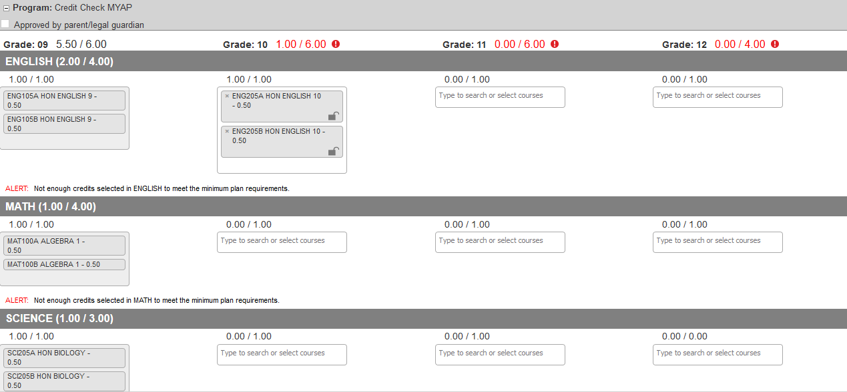
Academic 4- year Planning
Located in Infinite campus. It is used to create your 4-year academic plan of courses.

Slide 18
English Courses
Junior Year
English 11
AP English Language
EVIT English 11
Senior Year
English 12
College Prep English
AP English Literature
EVIT English 12
* Be sure to select both semesters 1 and 2.

Slide 19
Science Courses
Chemistry or Honors Chemistry
Physics or AP Physics 1
Biotechnology 1
Ag Science 1 (followed by Ag Science 2 = 1 science core/1 Elective)
The following science courses can be taken after Chemistry
Human Biology
AP Biology
AP Chemistry
AP Environmental Science
*Be sure to select both semesters 1 and 2.

Slide 20
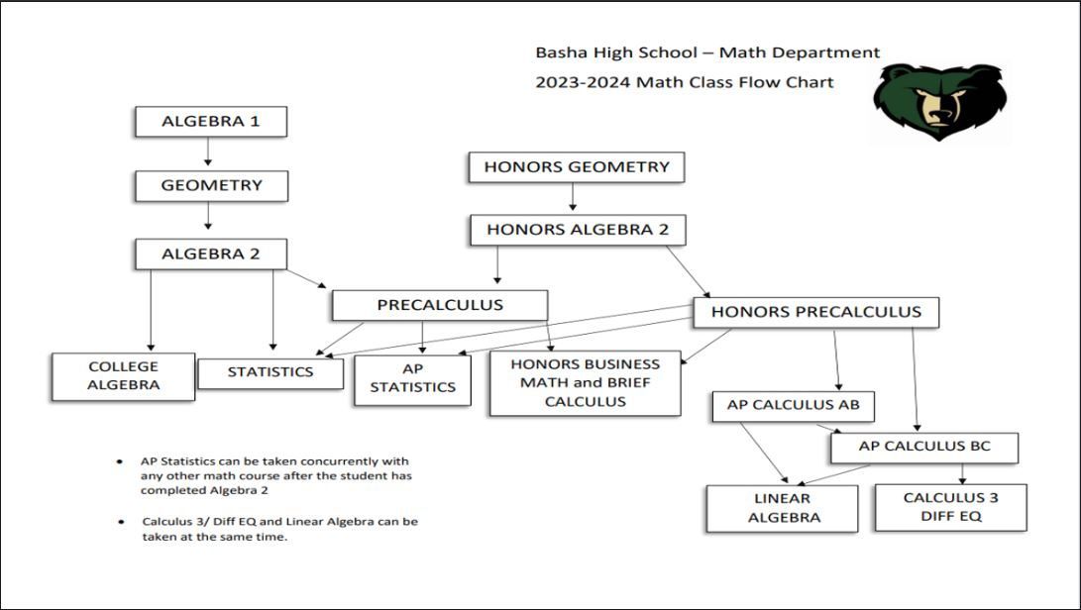

Slide 21
Social Studies Courses
Junior Year
American/AZ History
AP American/AZ History
Be sure to select both semesters 1 and 2.
Senior Year
US Gov’t & Const or AP Gov’t & Const (One sem.)
AND
Economics or AP Macroeconomics (One sem.)

Slide 22
Electives
Choose Electives for each year so that credits add up to 6.
Don’t forget to select both semesters for year-long electives.
Have you taken PE? Health?
Once you have 22 credits entered, SAVE your work.

Slide 23
Curious about EVIT?
*Students can start registering for EVIT at any time. Visit EVIT.com and download an application. www.evit.edu

Slide 24
EVIT Programs
3 D Animation
Aesthetics
Automotive Technology
Aviation
Computer Programming
Cosmetology
Culinary Arts
Dental Careers
Early Childhood Education
Fashion, Interiors and Textiles (FIT)
Fire Science
Future Engineers
Graphic Design
HVAC
Law Enforcement
Massage Therapy
Nursing Assistant
Pharmacy Tech
Photography
Physical Therapy Tech
Radio/Audio Production
Veterinary Assistant
Video Production
Welding

Slide 25
Sophomore ECAP (Education and Career Action Plan)
“CHOOSE A JOB YOU LOVE AND YOU WILL NEVER HAVE TO WORK A DAY IN YOUR LIFE” -Confucius

Slide 26
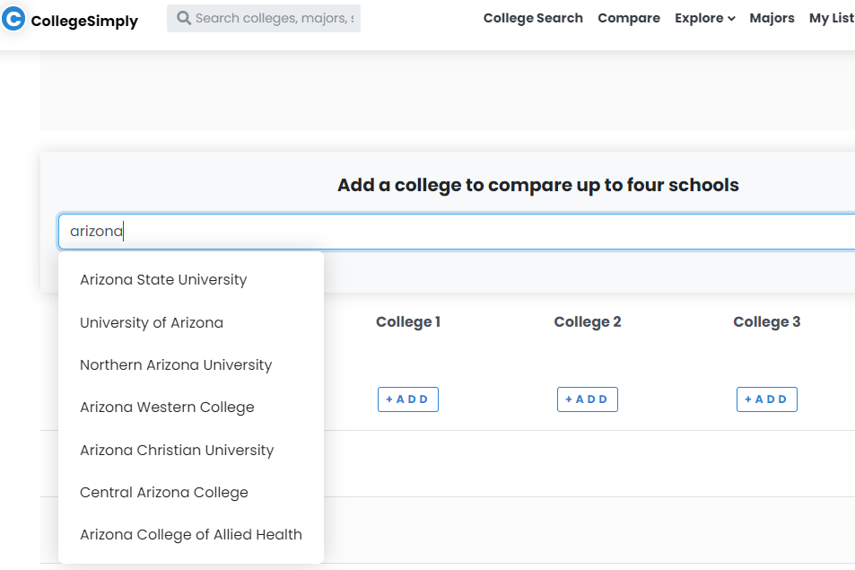
COMPARE COLLEGES
Go to www.collegesimply.com/colleges/compare/#
You can compare up to four colleges. Enter the name of the college (or the state it is located in) in the search box.

Slide 27
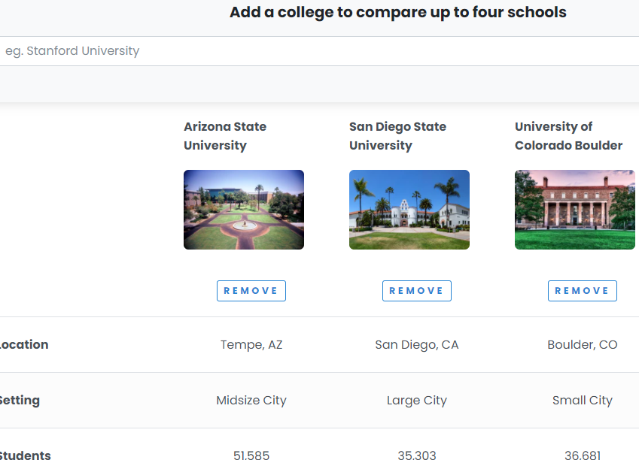
COMPARE COLLEGES
Once you select a college, the information for that school will be displayed. You can add and delete schools as you need to. Find at least three schools that you are interested in attending.
Enter this information on the comparison sheet that you have.

Slide 28
What Now?
Keep Grades Up
Join Clubs
Try out for Sports
Volunteer in Community
Be Involved on Campus
Be Kind and Have a Great Year!!!

